Slide 1
Internet and Web Technology ICT- 2205 Lecture - 8
Presented By:
Mehrin Anannya
Lecturer
Institute of Information Technology
Jahangirnagar University.

Slide 2
Contents
HTTP Response Message Format
HTTP Transfer Protocol Secure
HTTP Transfer Protocol State Retention: Cookie
HTTP Transfer Protocol Cache
HTTP/2.0

Slide 3
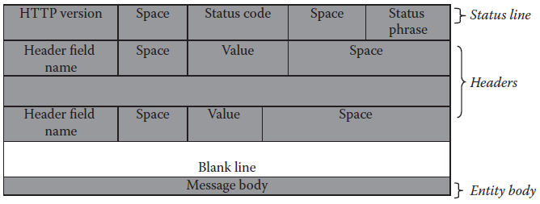
Hypertext Response Message Format

Slide 4
Hypertext Response Message Format
Status Line:
Status line consists of three parts: HTTP version, Status code, and Status phrase. Two consecutive parts are separated by a space.
HTTP version: This field specifies the version of the HTTP protocol being used by the server. The current version is HTTP/1.1.

Slide 5
Status code: It is a three-digit code that indicates the status of the response. The status codes are classified with respect to their functionality into five groups as follows:
1xx series (Informational)—This class of status codes represents provisional responses.
2xx series (Success)—This class of status codes indicates that the client’s request are received, understood, and accepted successfully.
3xx series (Re-directional)—These status codes indicate that additional actions must be taken by the client to complete the request.
4xx series (Client error)—These status codes are used to indicate that the client request had an error and therefore it cannot be fulfilled.
5xx series (Server error)—This set of status codes indicates that the server encountered some problem and hence the request cannot be satisfied at this time.

Slide 6
Hypertext Response Message Format (cont.)
Status phrase: It is also known as Reason-phrase and is intended to give a short textual description of status code. Some of status phrases commonly encountered are given in Table 4.1 of Akshi Kumar’s Book . The respective status code, phrase and its description are also provided there(in the search tab – 57/(86 of 249).

Slide 7

Hypertext Response Message Format (cont.)
Headers:
Headers in an HTTP response message are similar to the one in a request message except for one aspect, in place of request header in the headers it contains a response header.
The general header and entity header has the same purpose and structure as the request message.
The response header is discussed in the following:

Slide 8
Hypertext Response Message Format (cont.)
Response Headers:
Response headers help the server to pass additional information about the response that cannot be inferred from the status code alone, like the information about the server and the data being sent. Some response headers with their brief description are given in the following:
Location: http://www.mywebsite.com/relocatedPage.html
This header specifies a URL towards which the client should redirect its original request.
It always accompanies the “301” and “302” status codes that direct clients to try a new location.

Slide 9
Hypertext Response Message Format (cont.)
Response Headers (cont.):
WWW-Authenticate: Basic
This header accompanies the “401” status code that indicates an authorization challenge. It specifies the authentication scheme which should be used to access the requested entity. In the case of web browsers, the combination of the “401” status code and the WWW-Authenticate header causes users to be prompted for ids and passwords.
Server: Apache/1.2.5
This header is not tied to a particular status code. It is an optional header that identifies the server software.

Slide 10
Hypertext Response Message Format (cont.)
Response Headers (cont.):
Age:22
This header specifies the age of the resource in the proxy cache in seconds.

Slide 11
Hypertext Response Message Format (cont.)
Message Body:
Similar to HTTP request messages, the message body in an HTTP response message is also optional.
The message body carries the actual HTTP response data from the server (including files, images, and so on) to the client.
A sample response to the request message shown here.

Slide 12
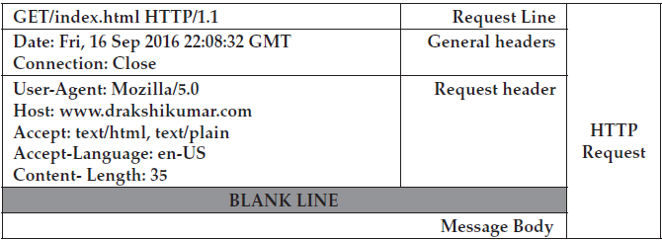
Hypertext Response Message Format (cont.)
Message Body (cont.):
HTTP Request Message

Slide 13
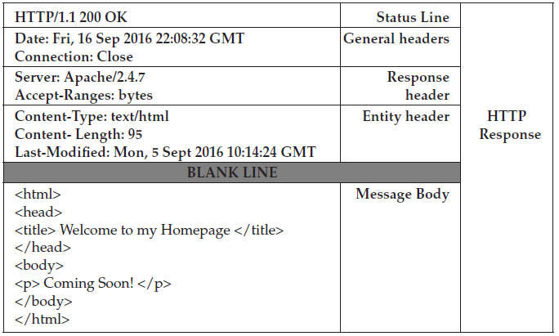
Hypertext Response Message Format (cont.)
Message Body(cont.):
HTTP Response Message

Slide 14
HTTP Transfer Protocol Secure
HTTPS is a protocol for secure communication over the Internet. It was developed by Netscape. It is not a protocol, but it is just the result of the combination of the HTTP and SSL/ TLS (Secure Socket Layer/Transport Layer Security) protocol.
It is also called secure HTTP, as it sends and receives everything in the encrypted form, adding the element of safety.
HTTPS is often used to protect highly confidential online transactions like online banking and online shopping order forms.

Slide 15
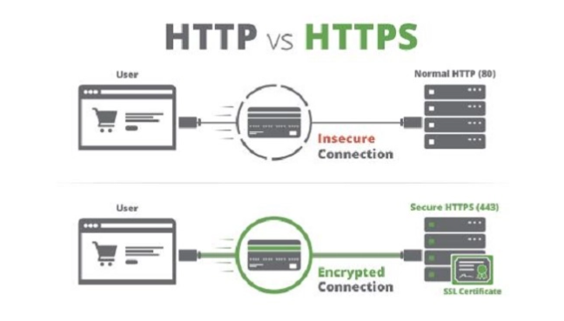
HTTP Transfer Protocol Secure (cont.)

Slide 16
HTTP Transfer Protocol Secure (cont.)
The use of HTTPS protects against eavesdropping and man-in-the-middle attacks. While using HTTP, servers and clients still speak exactly the same HTTP to each other, but over a secure SSL connection that encrypts and decrypts their requests and responses. The SSL layer has two main purposes:
Verifying that you are talking directly to the server that you think you are talking to.
Ensuring that only the server can read what you send it, and only you can read what it sends back.

Slide 17
HTTP Transfer Protocol Secure (cont.)
The really clever part is that anyone can intercept every single one of the messages you exchange with a server, including the ones where you are agreeing on the key and encryption strategy to use, and still not be able to read any of the actual data you send.
This helps increase the trust that clients/customers have in a service or business.
Example: When you order anything you hit the payment button. The browser’s HTTPS layer will encrypt it and the response from the server will also be decrypted by browser’s HTTPS ssub-layer.

Slide 18
HTTP Transfer Protocol State Retention: Cookie
HTTP is a stateless protocol.
Cookies are an application-based solution to provide state retention over a stateless protocol.
They are small pieces of information that are sent in response from the web server to the client.
Cookies are the simplest technique used for storing client state.
A cookie is also known as HTTP cookie, web cookie, or browser cookie.
Cookies are not software; they cannot be programmed, cannot carry viruses, and cannot install malware on the host computer.
However, they can be used by spyware to track a user’s browsing activities.
Cookies are stored on a client’s computer.

Slide 19
HTTP Transfer Protocol State Retention: Cookie
They have a lifespan and are destroyed by the client browser at the end of that lifespan.
A cookie is a combination of name and value, as in (name, value).
A web application can generate multiple cookies, set their life spans in terms of how many milliseconds each of them should be alive, and send them back to a web browser as part of an HTTP response.
If cookies are allowed, a web browser will save all cookies on its hosting computer, along with their originating URLs and life spans. be stored.

Slide 20
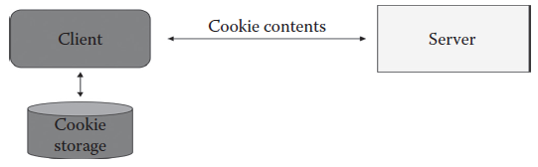
HTTP Transfer Protocol State Retention: Cookie
When an HTTP request is sent from a web browser of the same type on the same computer to a web site, all live cookies originated from that web site will be sent to the web site as part of the HTTP request.
Therefore, session data can be stored in cookies, thus, the state can

Slide 21
HTTP Transfer Protocol State Retention: Cookie
An HTTP cookie is a small file that is provided by the server as an HTTP response header, stored by the client and returned to the server as an HTTP request header.
This is the simplest approach to maintain session data. Since the web server doesn’t need to commit any resources for the session data, this is the most scalable approach to support session data of large number of users. But it is not secure or efficient for cookies to go between a web browser and a web site for every HTTP request, and hackers could eavesdrop for the session data along the Internet path.

Slide 22
HTTP Transfer Protocol State Retention: Cookie
There are 4 types of cookies:
Session cookie : A session cookie only lasts for the duration of users using the website. The web browser normally deletes session cookies when it quits.
Persistent cookie/ tracing cookie: A persistent cookie will outlast user sessions. If a persistent cookie has its max-age set to 1 year, then, within the year, the initial value set in that cookie would be sent back to the server every time the user visited the server.
Secure cookie : A secure cookie is used when a browser is visiting a server via HTTPS, ensuring that the cookie is always encrypted when transmitting from client to server.
Zombie cookie: A zombie cookie is any cookie that is automatically recreated after the user has deleted it.

Slide 23
HTTP Transfer Protocol Cache
Fetching something over the network is both slow and expensive: large responses require many roundtrips between the client and server. As a result, the ability to cache and reuse previously fetched resources is a critical aspect of optimizing for performance.
Caching is the term for storing reusable responses in order to make subsequent requests faster.
The caching of web pages is an important technique to improve the Quality of Service (QoS) of the web servers.
Caching can reduce network latency experienced by clients.

Slide 24
HTTP Transfer Protocol Cache(cont.)
For example, web pages can be loaded more quickly in the browser. Caching can also conserve bandwidth on the network, thus increasing the scalability of the network with the help of an HTTP proxy cache (also known as web cache).
Caching also increases the availability of web pages. Web resources that are cached remain accessible even if the source of the resources or an intermediate network link goes down.
Content can be cached at many different points throughout the delivery chain:
Browser cache: Web browsers themselves maintain a small cache. Typically, the browser sets a policy that dictates the most important items to cache. This may be user-specific content or content deemed expensive to download and likely to be requested again.

Slide 25
HTTP Transfer Protocol Cache(cont.)
Intermediary caching proxies (Web proxy): Any server in between the client and your infrastructure can cache certain content as desired. These caches may be maintained by ISPs or other independent parties.
Reverse cache: Your server infrastructure can implement its own cache for backend services. This way, content can be served from the point-of-contact instead of hitting backend servers on each request.

Slide 26
HTTP Transfer Protocol Cache(cont.)
A Web proxy is the most commonly used caching service.
A proxy is an application program or a computer system that behaves like an intermediary between servers and clients looking for services from these servers.
To access a resource, a client sends the request to proxy instead of the original web server.
The proxy, in turn, searches for the resource in its cache.
If the resource is found, it is delivered to the client. Otherwise, it contacts the specified server and gets the resource, puts that resource in its local cache, and finally returns the resource to the client.
The subsequent requests for the same resource are served by the copy in its local cache thereby avoiding remote web server access.

Slide 27
HTTP Transfer Protocol Cache(cont.)
Advantages of using a cache are:
Decreased network costs: Content can be cached at various points in the network path between the content consumer and content origin. When the content is cached closer to the consumer, requests will not cause much additional network activity beyond the cache.
Improved responsiveness: Caching enables content to be retrieved faster because an entire network round trip is not necessary. Caches maintained close to the user, like the browser cache, can make this retrieval nearly instantaneous.

Slide 28
HTTP Transfer Protocol Cache(cont.)
Advantages of using a cache are (cont.):
Increased performance on the same hardware: For the server where the content originated, more performance can be squeezed from the same hardware by allowing aggressive caching. The content owner can leverage the powerful servers along the delivery path to take the brunt of certain content loads.
Availability of content during network interruptions: With certain policies, caching can be used to serve content to end users even when it may be unavailable for short periods of time from the origin servers.

Slide 29
HTTP/2.0
At a high level, HTTP/2 is binary, instead of textual, fully multiplexed, instead of ordered and blocking
It uses one connection for parallelism.
It uses header compression to reduce overhead and allows servers to “push” responses proactively into client caches.
The standard was prepared on an unrealistically short schedule and has some encryption issues. In lieu of this, it has faced a lot of criticism.

Slide 30
Summary
HTTP response message format three parts Status line, Headers & Message/Entity body.
HTTP becomes secured when it sends and receives everything in the encrypted form, adding the element of safety.
An HTTP cookie is a small file that is provided by the server as an HTTP response header, stored by the client and returned to the server as an HTTP request header.
Caching is used for storing reusable responses in order to make subsequent requests faster.

